Slide 1
TPhoenix AWS Demo
Hossein Talebi
30 March 2021

Slide 2







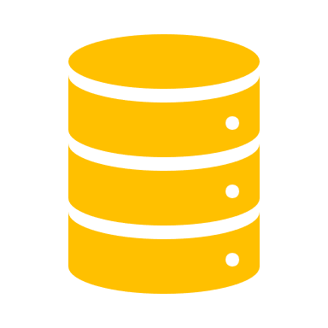

TPhoenix Project (PRID21016)
Project Lead: Eric Kamps
Prepare and establish a deployment pipeline into the production environment and at the same time introduce DevOps (SAFe and lean manufacturing) concepts in the WoW and cooperation between IT, operations and development.
The end goal for this project is to deploy TDLog instances into production via this pipeline.
TDLog and its components are mainly in charge of detecting double UIDs in production.
It is written in C#
TDLog is containerized
Currently its database contains over 40B UIDs.
TDLog can live in NS, therefore we consider to deploy to the public cloud
API
API
Other production apps
API
Sync
Global
API
Service
INPUT
OUTPUT
API
Service
Tester J750/PS1600
Local
UID file

Slide 3
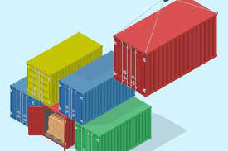


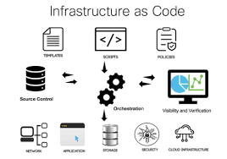
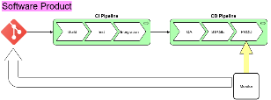

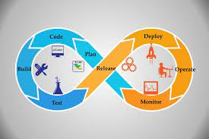
This Demo
Containerization
Source
Code (Dev)
TP-Unicorn Structure
AWS Elastic Container Service (ECS)
Local and cloud-based dev
Building the Code
Orchestration
Infrastructure as Code
CI/CD Pipelines
Logging,
Monitoring
DevOps

Slide 4





Architecture

Slide 5
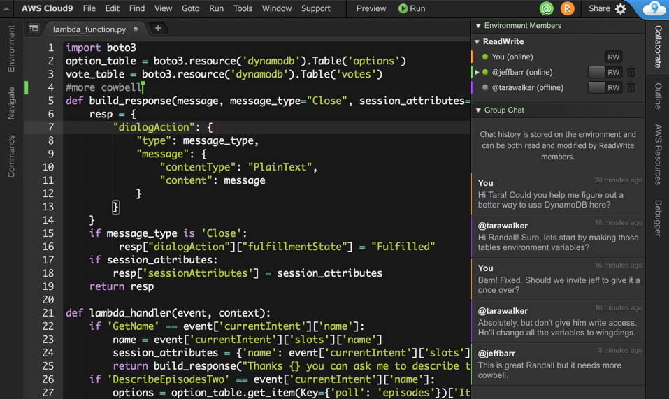

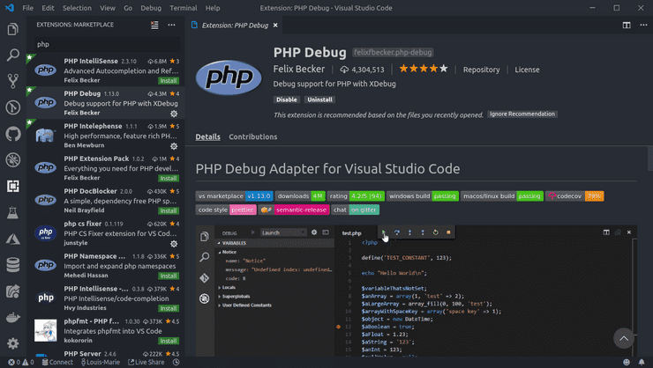

Build and Release
Historically Visual Studio is used.
Local Build (VSCode Remote)
Cloud9

Slide 6


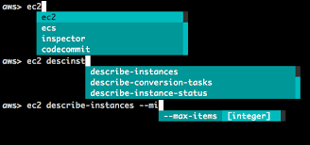
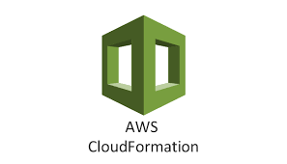
Deployment
Docker compose
AWS Command line
Cloudformation
Kubernetes (Helm Charts)

Slide 7
Building the Cluster (VPC, subnets, Security Groups)
NFS Storage
Linux Instance
ECS: Service Discovery , Tasks, Service Definitions
TP Unicorn Demo
Health check
Circulating data
Persisting Data
Mount Test
Disk Speed Test
Logging: Cloudwatch

Slide 8
Some Insight
Pros
Building a DevTest environment in matter of minutes (Codecommit, Cloud9, VMs)
ECR and ECS quite easy to setup and use
Logging and Monitoring is very easy, some minutes to setup
Storage is unlimited and can be configured according to the demand
Cons
The Cloudformation way of describing the recourses was not so easy
ECS is specific to AWS
Lengthy discussions, support issues, stability, backups, etc.
Difficult to design, setup and maintain even in easy cases (docker swarm)
ELK, and now Splunk
Often issues with storage

Slide 9
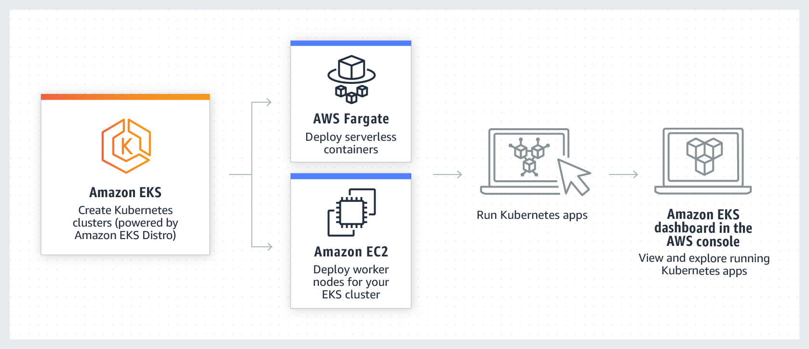
Next Steps
Build the CI/CD Pipeline
Deploy to Elastic Kubernetes Service (EKS)
Deploy TDLog to EKS
MS SQL Server optimization
Connecting to Test Sites (data sources)

